Slide 1
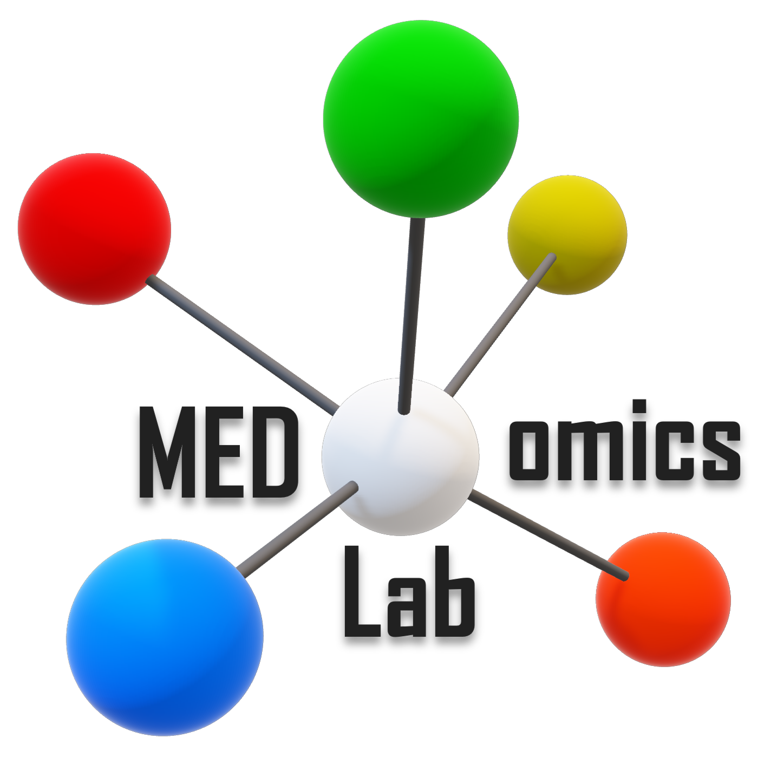
Integrative modeling of heterogeneous data in medicine
Web: medomicslab.org
(not yet online)
Update: October 6th, 2023

Slide 2

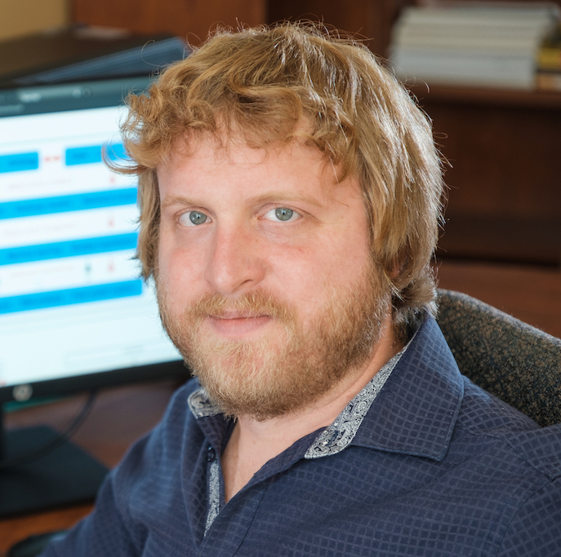
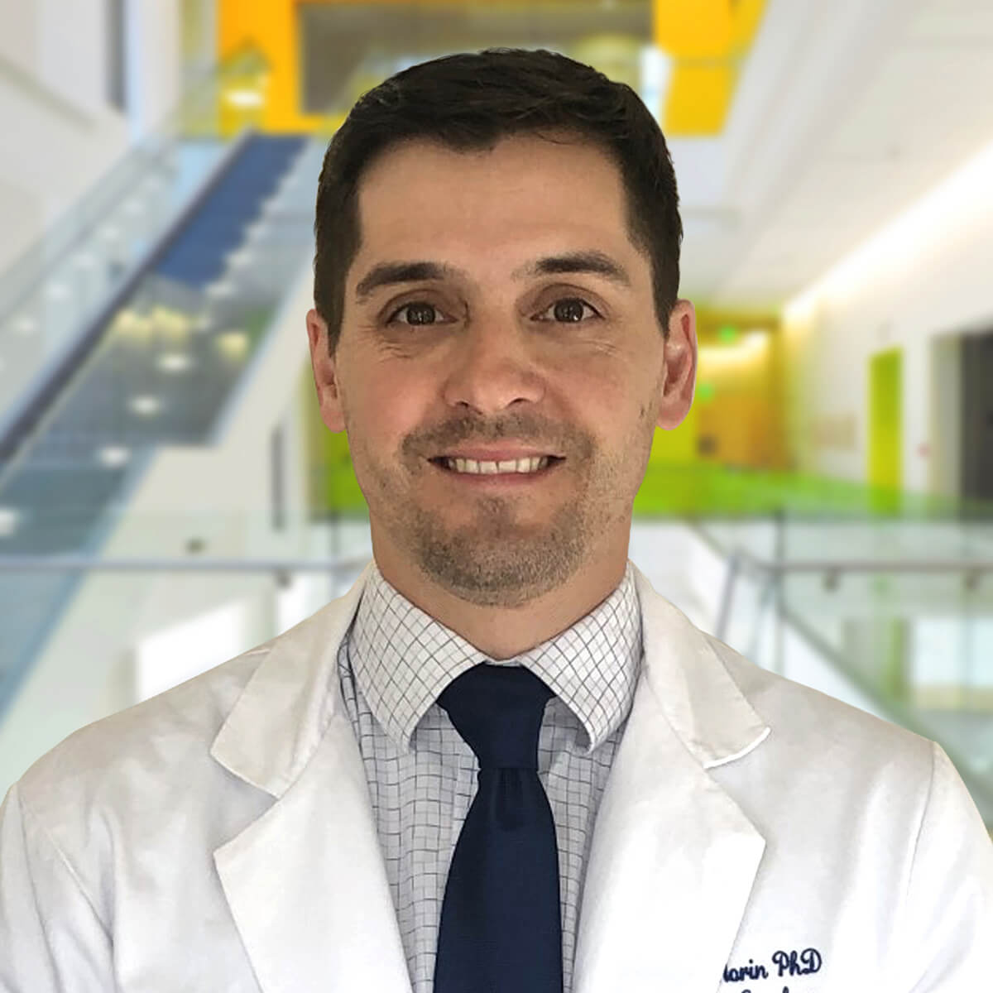




CO-LEADERS
Martin Vallières, PhD
Olivier Morin, PhD
Assistant Professor
Department of Computer Science
Université de Sherbrooke
Researcher – CRCHUS
Canada CIFAR AI Chair, Mila
Web: medomics-udes.org
Associate Professor
Department of Radiation Oncology
University California San Francisco
Web: medomics.ai

Slide 3



Slide 4


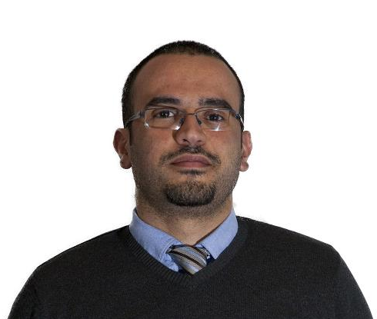
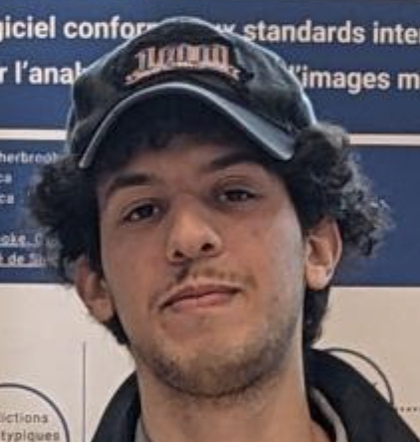

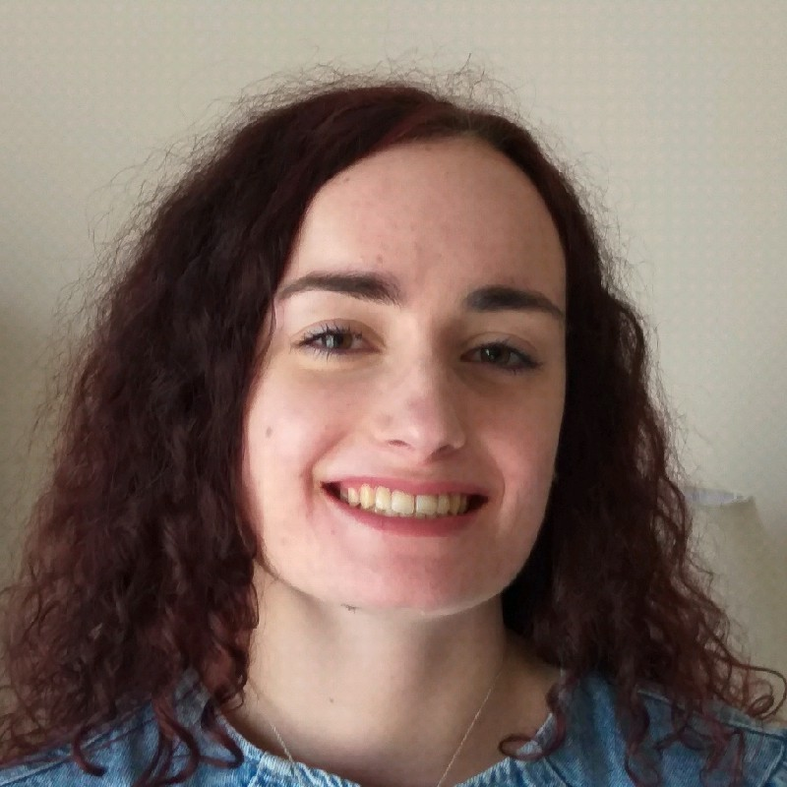

DEVELOPMENT TEAM
Guillaume Blain
Research Assistant
Université de Sherbrooke
Andréanne Allaire
Research Assistant
Université de Sherbrooke
Brahim Fakri
Research Assistant
Université de Sherbrooke
Mahdi Ait Lhaj Loutfi
MSc + Research Assistant
Université de Sherbrooke
Nicolas Longchamps
Research Assistant Université de Sherbrooke
Sarah Denis
Research Professional
Université de Sherbrooke
Hithem Lamri
Collaborator
Formerly at Université de Sherbrooke

Slide 5




PARTNERS
prevalis.recherche.usherbrooke.ca
medomics.ai
reseau1quebec.ca
ssaquebec.ca

Slide 6
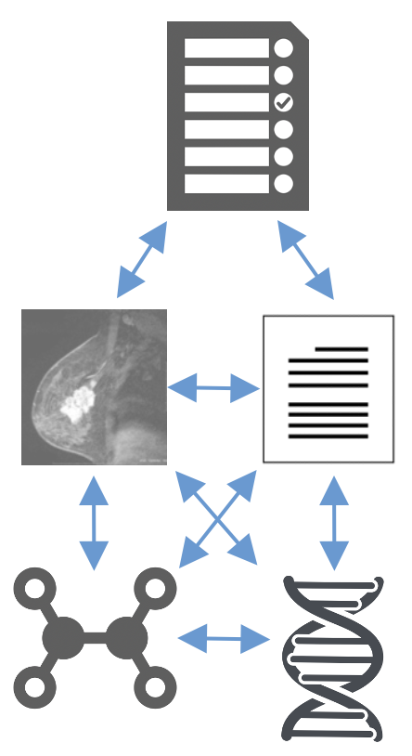
MEDomicsLab
Integrative modeling of heterogeneous data in medicine
+
+
MED
omics
Lab
Characterization of biological processes
Heterogeneous
medical data
Working platform
Development of predictive models
for personalized treatments

Slide 7

MAIN GOAL
Help medical AI teams to better work together
TRADITIONAL PARADIGM
“MEDomicsLab” PARADIGM
CLINICAL
SCIENTIST
Clinical problem
Data collection
CLINICAL
SCIENTIST
Clinical problem
Data collection
Data management
AI hypotheses
AI computing
Results visualization
Data management
AI hypotheses
AI computing
Results visualization
COMPUTER
SCIENTIST
COMPUTER
SCIENTIST
AI refinements
Sequential process
Synergistic process

Slide 8




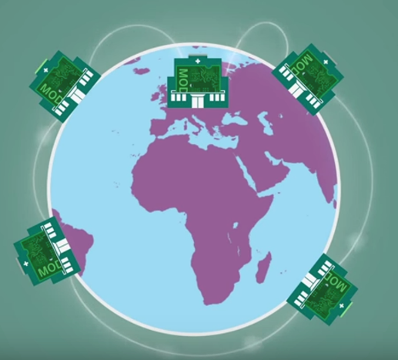
OVERVIEW
MEDomicsLab
DATA ⎼ Input points
INTERDISCIPLINARY RESEARCH TEAMS
f
Expert
analyses
FRONT-END INTERFACE
BACK-END CODE
Hospital
Databases
CODE
GENERATOR
NOTEBOOKS
LAYERS
MODULES
Wrappers
Pipelines
Packages
Medical data
engineers
Computer
scientists
MODEL ⎼ Applications
External collaborative teams

Slide 9
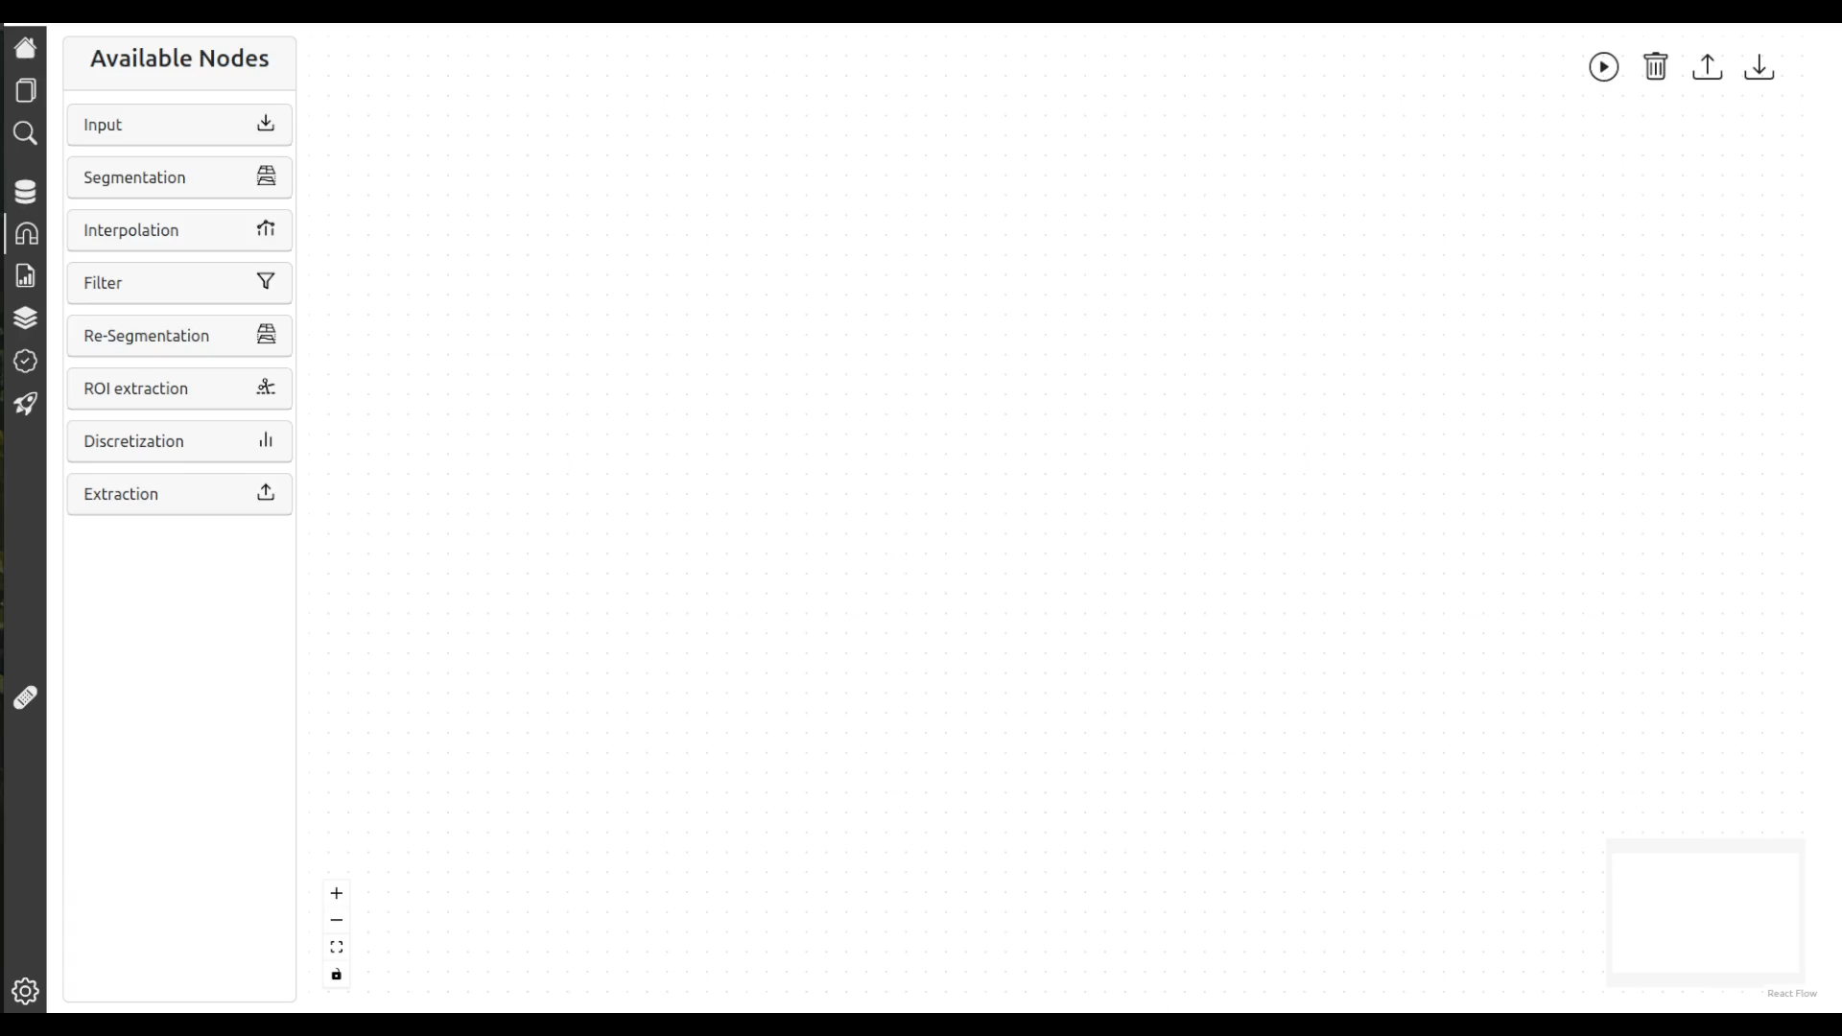
SAMPLE VIDEO
(radiomic feature extraction via MEDimage)
Credits: Andréanne Allaire

Slide 10
CURRENT SCOPE
PROCESS TYPE | ✅ | FUTURE WORK | 🚫
GENERAL | Local research use | Remote server management | Cloud integration
DATA | CSV and DICOM formats Tabular, time-series, text and medical imaging data Deep feature extraction from pre-trained models | FIHR format Ontologies and relational DB | Specialized data formats
MODELING | Multiple static time points Machine learning : classification, regression and survival analyses Predictive modeling | Longitudinal analyses Basic deep learning Hierarchical GNN learning Continual learning Import/Export expert scripts | Expert computer vision Expert NLP Expert multi-omics analyses Expert biomedical signal analyses Expert DL, RL, SSL …

Slide 11

MEDomicsLab
WORKFLOW
I → Input points
O → Output points
LONGITUDINAL
CSV table
Input module
Extraction module
IMAGES
DICOM
I
DESIGN
LAYER
I
Prepare static tables
Feature extractor
TIME SERIES
CSV table
STATIC
CSV table
Exploratory module
I
TEXT
CSV table
I
EDA
I
Machine Learning (ML) module
Evaluation module
Federated Learning (FL) module
DEVELOPMENT
LAYER
Experiment ⎼ Finalize model
Test model ⎼ Explain model
Simulate FL
Collaboration
Application module
DEPLOYMENT
LAYER
Apply model ⎼ Deploy model
MODEL
I
O

Slide 12
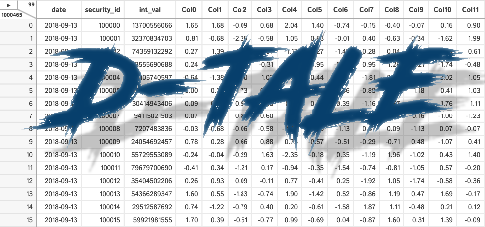





MAIN PACKAGE LIST
MODULES
INPUT
EXPLORATORY
EXTRACTION
ML
EVALUATION
FL
APPLICATION
scikit
survival

Slide 13
TIMELINE
FALL 2023
Completion of V1 (online version)
Documentation
Tutorials (MIMIC)
Working document
* UX/UI designer ?
WINTER 2024
V1 testing phase
(with partners)
MEDfl and MED3pa packages: new developments and integration in front-end interface
(new interns)
FALL 2024
V2 development
MEDomicsLab training
SUMMER 2024
MEDomicsLab paper
Ongoing developments, Support, Maintenance, Tests with other datasets …

Slide 14
CONCLUSIONS
We envision the MEDomicsLab platform to become a tool that will improve the synergy among medical AI research teams by:
Different levels of complexity/flexibility of usage include:
We invite partners to follow the developments on our GitHub (https://github.com/MEDomics-UdeS/MEDomicsLab) and to prepare for the testing phase in the Winter 2024 semester (~1 hour per week).
Empowering clinicians to design their own experiments (front-end)
Allowing computer scientists to quickly adapt experiments (front-end)
Refining the previously designed experiments (back-end)
Built-in pipelines in a user-friendly interface (front-end)
Customizable pipelines with setting options (front-end)
Code generation (front-end)
Modular code libraries in Python (back-end)

